Slide 1


2022 International Conference for Advancement in Technology (ICONAT 2022)
Analysis of Stock Price Prediction using Machine Learning Algorithms
Paper ID : 512
By
Manav Hirey,
Jaimeen Unagar,
Kshitij Prabhu,
Ronak Desai.

Slide 2
Outline
1. Introduction
2. Literature Survey
3. Methodology
4. Implementation
5. Results and Discussion
6. Conclusion
7. Future work
References

Slide 3
1. Introduction
Problem Definition
For a long time, stock price prediction has been a prominent area of research. Although it is hard to completely anticipate stock prices, there are formal assertions proving that effective modelling and design of relevant variables may lead to models that can very accurately predict stock prices and stock price movement patterns.
Researchers have also concentrated on stock technical analysis in attempt to uncover patterns in stock price movements using modern data mining techniques.

Slide 4
1. Introduction
Objectives
In this research, we provide a hybrid modelling technique for stock price prediction based on numerous machine learning and deep learning models.
We will be comparing three different algorithms for stock price prediction, which are namely :
Linear Regression
Auto ARIMA
LSTMN

Slide 5
2. Literature Survey
Serial Number | Paper Name | Author | Abstract
1 | Matplotlib: A 2D Graphics Environment | J. D. Hunter | Matplotlib is a 2D graphics package used for Python for application development, interactive scripting,and publication-quality image generation across user interfaces and operating systems
2 | Stock Price Prediction And Forecasting Using Stacked LSTM-Deep Learning | Krish Naik | Based on numerous machine learning and deep learning models. The results clearly suggest that the LSTM-based univariate model, which uses one-week historical data as input to estimate the closing value
3 | Array programming with NumPy | Harris, C.R., Millman, K.J., van der Walt | NumPy is the primary array programming library for the Python language. It has an essential role in research analysis pipelines in fields as diverse as physics, chemistry, astronomy, geoscience, biology, psychology, materials science, engineering, finance and economics.

Slide 6
3.Methodology
Data Collection
Splitting Train and Test Data (80% for training and the remaining 20% for testing.
Machine Learning Algorithms Used:
Linear Regression
Auto - Arima
Long Short Term Memory

Slide 7
4.Implementation
Linear Regression
Implementation for current values
After uploading our dataset as a data frame, our first step is to check for null values in the column ‘Open’ and drop all such values.
We now split our original data frame into two, one consisting of the high, opening, low prices and the volume traded and the other consisting of the closing price for the day.
We now split the two data frames; train and test data into a ratio of 80:20
Next, we fit the training set to our regression model, and then we compare the result for the actual vs the predicted values on our test set.
To compare both the values side-by-side, we plot them next to each other by using a bar graph.
Implementation for future values
Following that, we attempt to forecast the stock's closing price 25 days in the future. To do this, we first create a new data frame with simply the stock's closing price and then add a new column to record the forecasted closing price of the stock. Then, using the same procedure as before, we calculate the stock's future price.

Slide 8
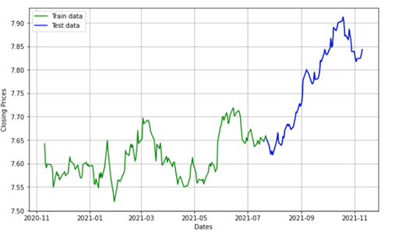
4.Implementation
Auto-ARIMA
Consider the following scenario: you have one value A that is influenced by another value B. To perform linear regression, you must first determine the connection between data points A and B
These two values, A and B, are now connected so that A's present value is dependent A's previous value. Therefore, the value of A will be given by its existing value. We take the dataset and build an ARIMA model.
Now we build an ARIMA model and train it with the stock's close price from the trained data. To see the data, divide it into training and test sets. We divided the dataset in 70% capacity into Train and Test data.
We use Root Mean Squared Error (RMSE) to measure how spread out the data is.
It represents how concentrated the data is around.
The RMSE value for Auto-ARIMA is approximately 1069

Slide 9
4.Implementation
Long Short Term Memory(LSTM)
The Long Short-Term Memory Network (LSTMN) is an enhanced RNN (sequential network) that permits information to be stored indefinitely.
We partitioned the data differently while training Time series data. We train the data with the appropriate date.The test size should be the difference between the length of the dataset and the training size, during this implementation we reserved 80 percent of the data as train data and the rest of it as test data.
LSTMs are extensively used and have shown to be extremely successful for sequence prediction applications. The main reason for them to work so well is that LSTM can recall important information from the past while forgetting irrelevant stuff.
To build a stacked LSTM model, first design the sequential model, then add two 50-unit LSTM layers, followed by two dense layers with unit values of 25 and 1, respectively. The Adam optimizer is used, and the mean squared value is specified as the loss function
We calculate the RMSE value by the formual mentioned in Auto-ARIMA. For this algorithm the observed RMSE value is 64.32

Slide 10
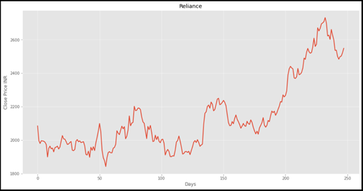
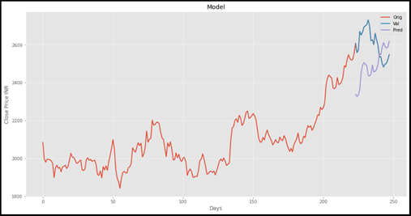
5. Results and Discussion
Linear Regression results
Graph of Original Price
Graph of Predicted Price

Slide 11
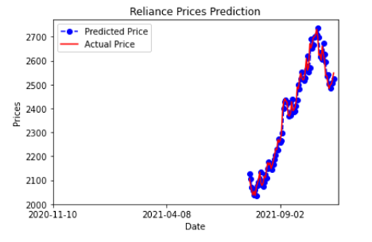
5. Results and Discussion
Auto-ARIMA results
The prediction of closing values for 25 days is found out using the created ARIMA model
Graph of Predicted Price

Slide 12
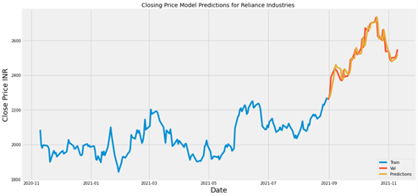
5. Results and Discussion
LSTM results
The prediction of closing values for 25 days is found out using the created ARIMA model
Graph of Predicted Price

Slide 13
6. Conclusion
The anticipated RIL prices are shown in the final Predicted graph for each regression.
We may conclude from this that the optimum method for predicting share closing prices is to use an LSTM-based univariate model that predicts values for 25 days

Slide 14
References
[1] Krish Naik, Stock Price Prediction And Forecasting Using Stacked LSTM-Deep Learning, May. 2020. Accessed on: Nov. 2, 2021. [Online]. Available: Stock Price Prediction And Forecasting Using Stacked LSTM- Deep Learning.
[2] Neural Nine, Predicting Stock Prices in Python, Feb. 2021. Accessed on:Nov.2,2021.[Online]. Available: Predicting Stock Prices in Python.
[3] Kirill Eremenko Hadelin de Ponteves, Deep Learning A-Z™: HandsOn Artificial Neural Networks, Nov. 2018. Accessed on:Nov.2,2021.[Online].Available: Deep Learning AZ™: Hands-On Artificial Neural Networks | Udemy.
[4] Chollet, F. & others, 2015. Keras. Available at: keras-team/keras: Deep Learning for humans.
[5] Scikit-learn: Machine Learning in Python, Pedregosa et al., JMLR 12, pp. 2825-2830, 2011.
[6] Harris, C.R., Millman, K.J., van der Walt, S.J. et al. Array programming with NumPy. Nature 585, 357–362 (2020). DOI: 10.1038/s41586-020-2649-2. (Publisher link).
[7] Data Ranger, Time Series Analysis Using Python, May. 2020. Accessed on:Nov.2,2021.[Online].Available: Time Series Analysis Using Python | Auto ARIMA.
[8] Hardik Kumar Dhaduk, Stock market forecasting using Time Series analysis With ARIMA model, June. 2021. Accessed on:Nov.2,2021.[Online].Available: https://www.analyticsvidhya.com/blog/2021/07/stock-marketforecasting-using-time-series-analysis-with-arima-model/ .
[9] Sanjay P, Stock Price Prediction and Forecasting using Stacked LSTM, May. 2021. Accessed on:Nov.2,2021.[Online].Available: https://www.analyticsvidhya.com/blog/2021/05/stock-priceprediction-and-forecasting-using-stacked-lstm/.
[10] J. D. Hunter, "Matplotlib: A 2D Graphics Environment", Computing in Science & Engineering, vol. 9, no. 3, pp. 90-95, 2007. Available at: https://ieeexplore.ieee.org/document/4160265.

